Slide 1
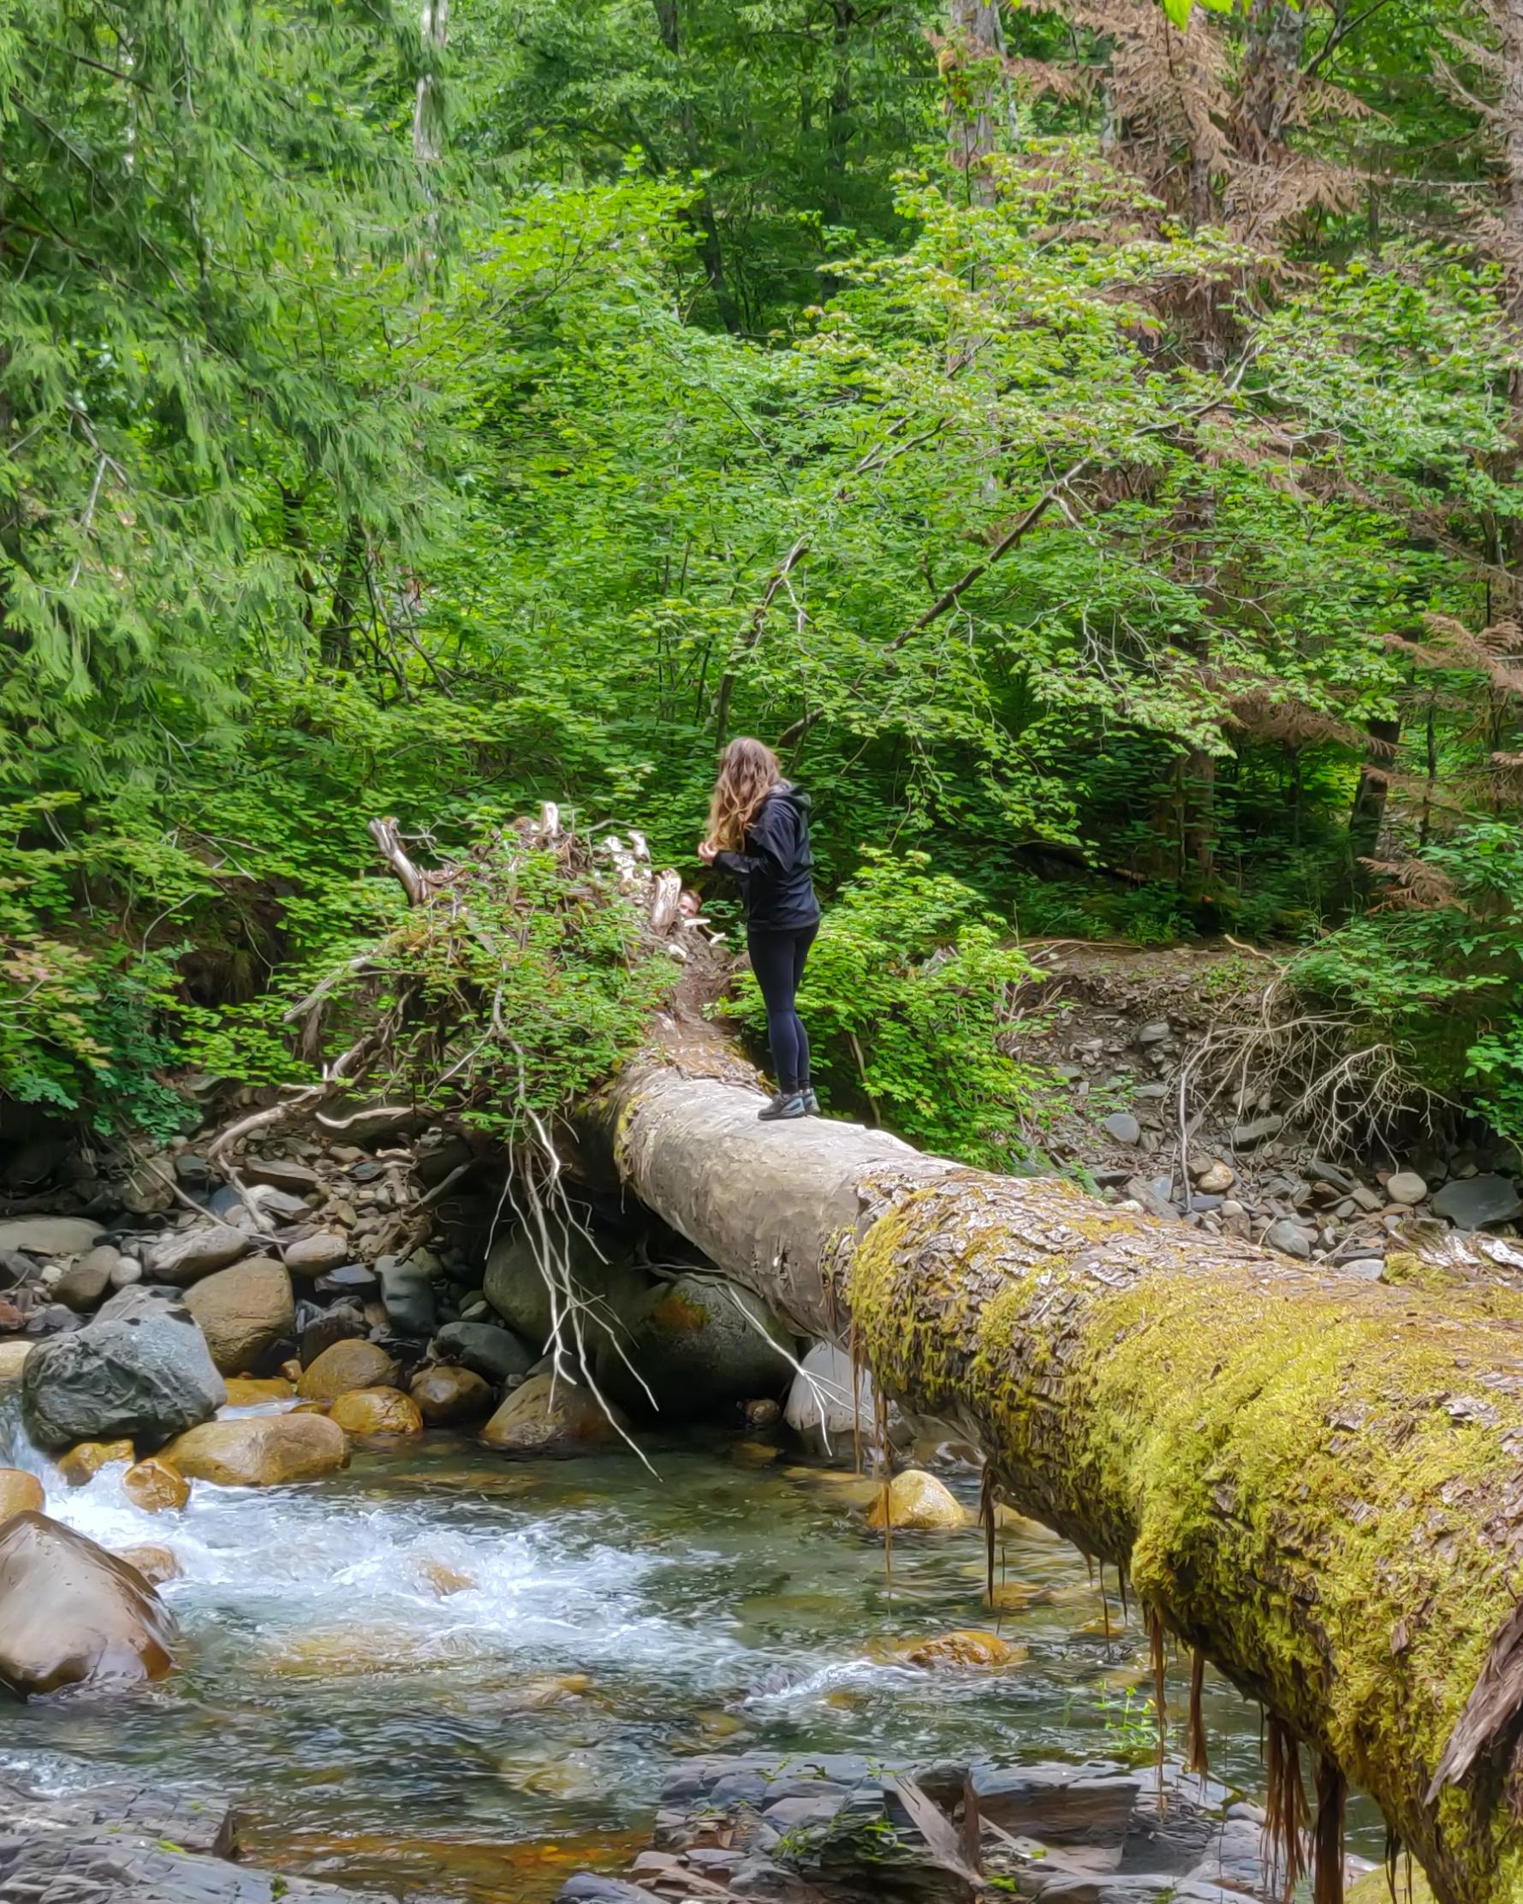
TrailRider 5.0 Overview
November 20, 2019
Team 10
Lukas Slotman • Ratthamnoon Prakitpong • Andrea Escoto
Julia Zhuravleva • Stephen Abraham • Carson Hopkins

Slide 2
Outline
Introduction
Background
Purpose
Value Proposition
Analysis
Stakeholders & Needs
Scope
Conclusion
Highest Scoring Design
Recommendation & Next Steps
Introduction
Analysis
Conclusion

Slide 3
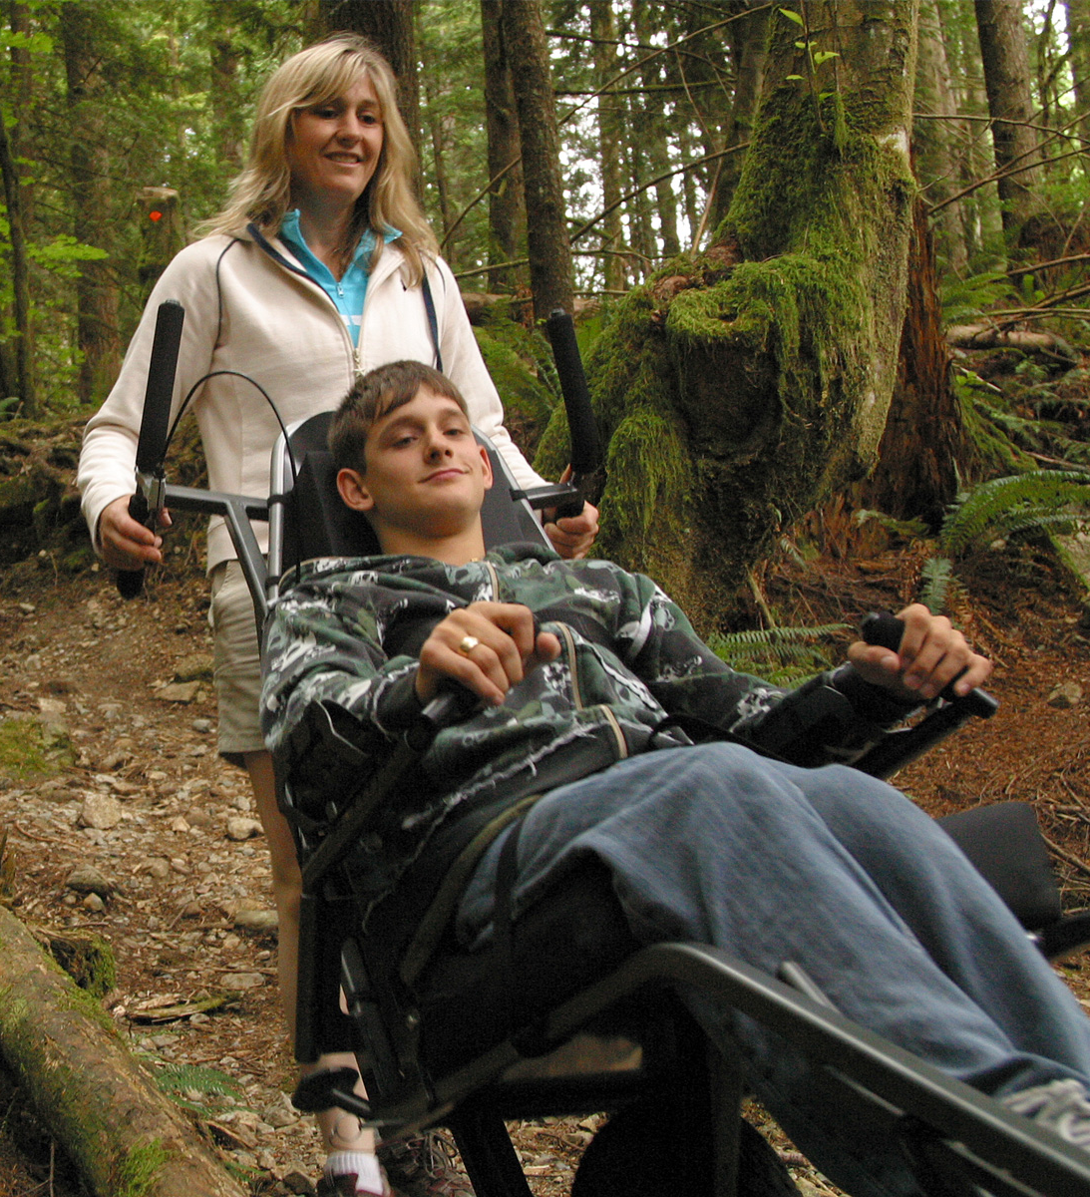
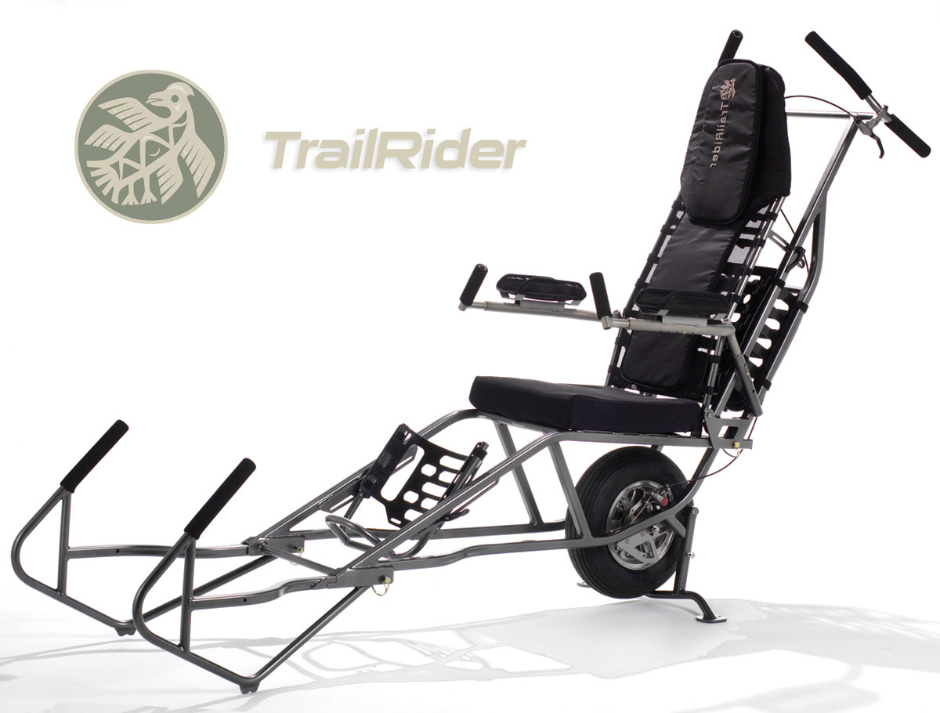
Background
UBC Mechanical Engineering department
Supervisor
Main client
BCMOS
Organize outdoor hikes for disabled people in BC
Main client and stakeholder
TrailRider 4.0
Terrain wheelchair (see right)
Introduction

Slide 4
Purpose
Value Proposition
Improve BCMOS' TrailRider 4.0
Proposed solution to UBC Mech. Dept. and BCMOS
Update current trail rider or have a parallel offering
Retain spirit of BCMOS
Enables people with mobility impairments to actively participate in social outings to explore unpaved terrain in semi-urban parks.
Introduction

Slide 5
Stakeholders & Needs
Ranked Stakeholders
BCMOS
Rider
Sherpa
Search & Rescue
Other hikers
Parks Staff
Manufacturer
Government
Analysis
Notes:
Image reference: http://www.precisionbalancing.com.au/industrial-balancing-news-balancing-centrifugal-pump-impellers.html

Slide 6
Stakeholders & Needs
Ranked Stakeholders
BCMOS
Rider
Sherpa
Search & Rescue
Other hikers
Parks Staff
Manufacturer
Government
Needs
Safety
Rider Interaction
Sherpa Usability
Cost
Portability
Durability
Ergonomics
Search & Rescue Compatible
Analysis
Notes:
Image reference: http://www.precisionbalancing.com.au/industrial-balancing-news-balancing-centrifugal-pump-impellers.html

Slide 7
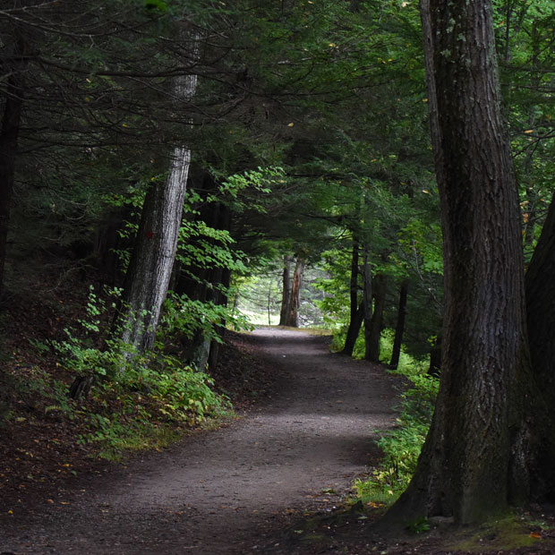
Scope
Focus on top 4 needs: safety, rider input, sherpa input, cost
Paraplegic or similar disabilities
“Only 45% of riders come back due to guilt for lack of involvement”
One sherpa or solo rider
Unpaved Urban Trails (eg. Stanley Park, Spanish Banks)
Analysis

Slide 8
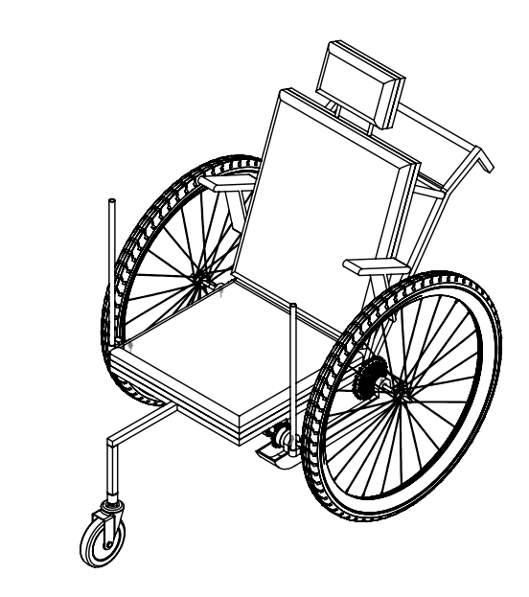
Highest Scoring Design Three-Wheeled Lever Chair
Lever-drive propulsion system
$2611 production cost
10 year service life
Self-balanced three-wheel design
Comfort-customizable geometry
Lightweight & portable (Detachable bicycle components)
Conclusion
Notes:
1:00 Est.
Thank you Andrea. So in summary of the analysis,
We developed each need into a series of requirements and target specifications.
Based on that we broke the design down to individually explore solutions to each of the primary functions.
Then we combined those solutions into full concepts which were scored in accordance with the target specifications we developed.
Of the full concepts we generated, the highest scoring design was the three-wheeled lever chair shown here.
It’s lever propulsion system directly addresses the two most significant areas of improvement we focused on; provided rider input towards device propulsion, and subsequently reducing the required sherpa input.
It came as no surprise that the three-wheeled lever chair emerged as the strongest option.
It has a relatively low $2611 product cost; 10 year predicted service life with minimal maintenance; places an emphasis on safety; allows for simple customization of the chair itself, and is both lightweight and portable.

Slide 9
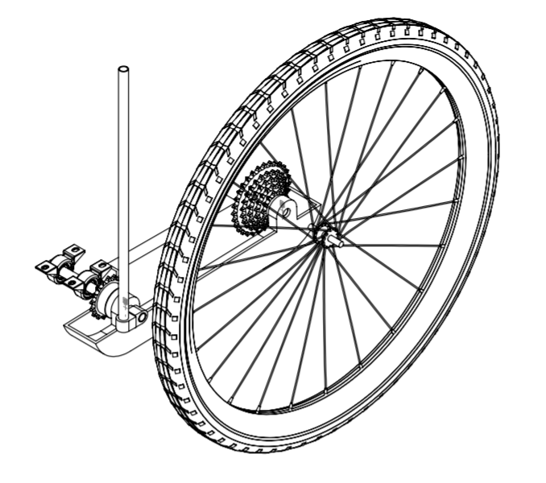
Lever Propulsion System
Bicycle cassette enables customizable gear ratio
Lever generates mechanical advantage for ease of propulsion
Conclusion
Notes:
0:30 Est
Our primary area of focus was in developing the lever drive propulsion system.
This utilizes a ratchet system on a lever arm which connects to the driven sprocket with a chain.
The ratio of the chain can be adjusted by removing links and setting it to a different location on the cassette for customization.

Slide 10
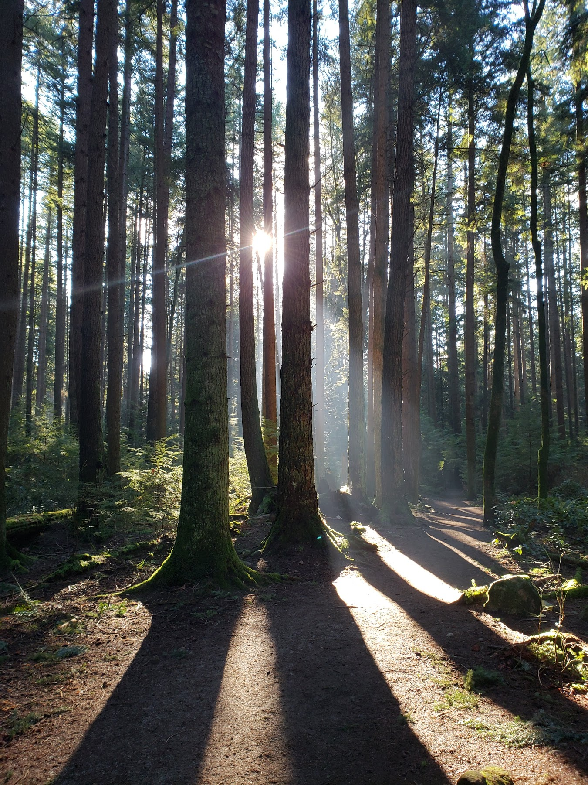
Recommendation Proceed with the Three-Wheeled Lever Chair
Superior functionality for semi-urban adventures on unpaved terrain
Maintains BCMOS’ spirit at an affordable price point
Next Steps
Develop prototype, Test durability, Refine ergonomics
Conclusion
Notes:
1:00 Est
We recommend to proceed with the three-wheel lever chair.
It essentially would be an alternative or parallel offering to the current version 4.0 trail rider.
The value in proceeding with this parallel offering is that is better addresses the majority or riders who want to be physically involved,
and it is better suited to semi - urban unpaved terrain which accounts for over 90% of current trail rider use.
Pending approval of this design, the next steps are to develop a physical prototype to do proper durability testing.
Time needs to be spent working on the ergonomics as well. Our design considered conservative human proportions and can easily be fitted with a variety of seat types and footrests.
This design maintains the spirit of BCMOS, enabling riders to partake in unpaved semi-urban adventures with the assistance of sherpas, the company of friends, or both.

Slide 11
TrailRider 5.0 Technical
November 20, 2019
Team 10
Lukas Slotman • Ratthamnoon Prakitpong • Andrea Escoto
Julia Zhuravleva • Stephen Abraham • Carson Hopkins

Slide 12
Outline
Strategy
Schedule
Project Risk Management
Concept Generation
Function Decomposition
Winnowing
Scoring
Evaluation Criteria
DFMEA
High Risk Mitigation
Project Outcome
Strategy
Strategy
Strategy

Slide 13
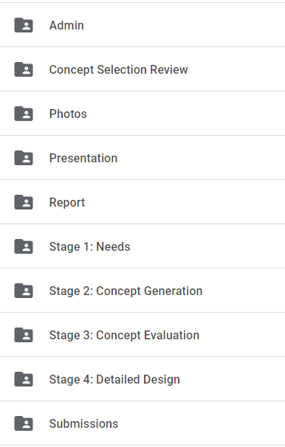
Strategy
More front-end work allows for buffer week
Split tasks based on individual strengths
Efficient meetings - more work, less talk
Effective communication
Organized Google Drive (see right)
S
Strategy
Concept Gen.
Scoring
DFMEA
Project Outcome

Slide 14
Scope Definition
Background
Stakeholders
Needs
Requirements
Concept Evaluation
Evaluation criteria
Scoring
Final concept
DFMEA 2
Design
Calculations & analysis
DFMEA 3
CAD & drawings
MATLAB optimization
LCA & costing
Report
Sept 16
Oct 9
Nov 20
Sept 9
Sept 23
Oct 16
Nov 15
Concept Generation
Function decomposition
Two C-Sketch rounds
DFMEA 1
Winnowing
CSR
Presentation
Strategy
Concept Gen.
Scoring
DFMEA
Project Outcome
Notes:
https://www.gracesguide.co.uk/J._and_H._Gwynne

Slide 15
Project Risk Management
Risks | Prevention | Action
Unfinished work in allotted time | Front-load work | Work on weekends
Members share unfair workload | Discuss team expectations | iPeer & team discussion
Frequent member absence | Time management | iPeer & team discussion
Lost documents | Store work in Google Drive | Recover from Google recycling bin; if unsuccessful, re-do work
Strategy
Concept Gen.
Scoring
DFMEA
Project Outcome

Slide 16
Function Decomposition
Top Needs:
Rider Interaction
Sherpa Usability
Safety
Device enables rider input towards propulsion
Device accepts input from sherpa
Device absorbs bumps
Device supports rider
Device changes speed relative to ground
Device changes direction relative to ground
Device balances upright
S
ztratStrategy
Strategy
Concept Gen.
Scoring
DFMEA
Project Outcome

Slide 17
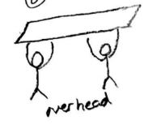
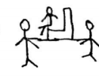
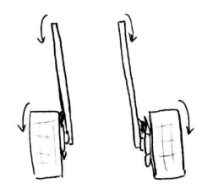
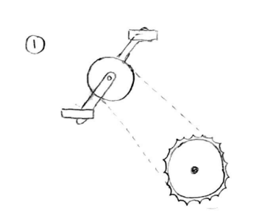
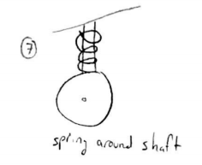
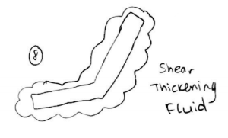
Concept Fragments
Two rounds of C-sketches
Concept fragments per function
Total: 47 concept fragments
Device accepts input from Sherpas
Device absorbs bumps
Device enables rider input towards propulsion
Strategy
Concept Gen.
Scoring
DFMEA
Project Outcome

Slide 18
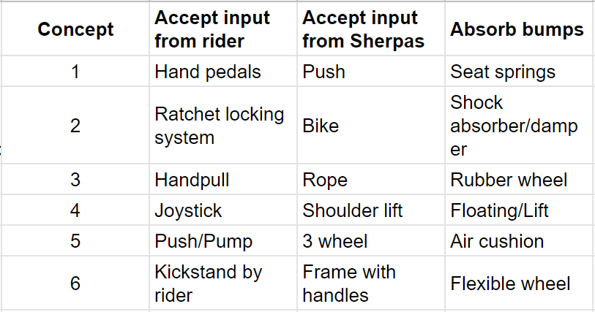
Full Concepts
Two concepts sketched by each person
Concepts contain unique fragments
Creative brainstorming
Total: 12 full concepts
Example of 6/12 Full Concepts
Strategy
Concept Gen.
Scoring
DFMEA
Project Outcome

Slide 19
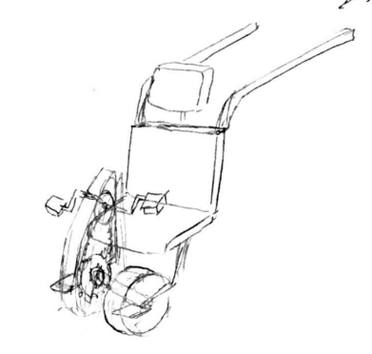
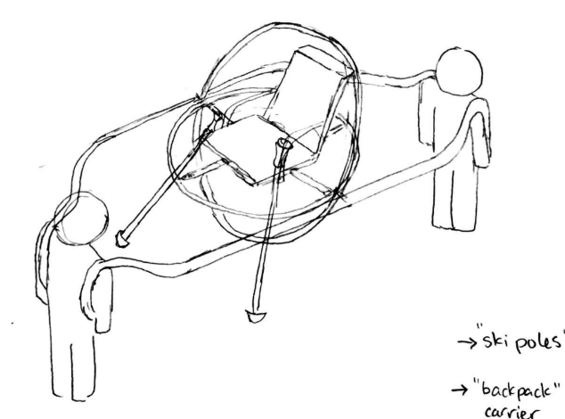
Examples of Full Concepts
Strategy
Concept Gen.
Scoring
DFMEA
Project Outcome

Slide 20
Winnowing
Winnowed concepts based on
Feasibility
Requirements
Technical Readiness
Similar concepts were combined
Result: 4 concepts passed
Concept A.1 | Concept A.2
Concept B.1 | Concept B.2
Strategy
Concept Gen.
Scoring
DFMEA
Project Outcome

Slide 21
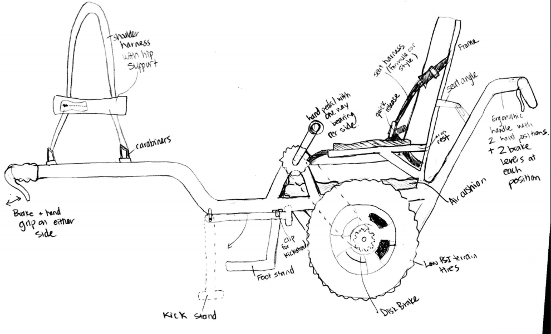
Concept A.1: “Two Wheel Chariot”
Strategy
Concept Gen.
Scoring
DFMEA
Project Outcome

Slide 22
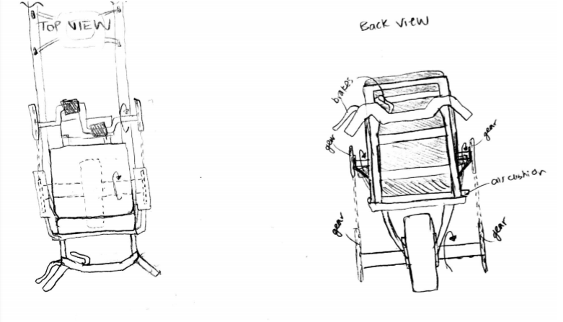
Concept A.2: “One Wheel Chariot”
Strategy
Concept Gen.
Scoring
DFMEA
Project Outcome

Slide 23
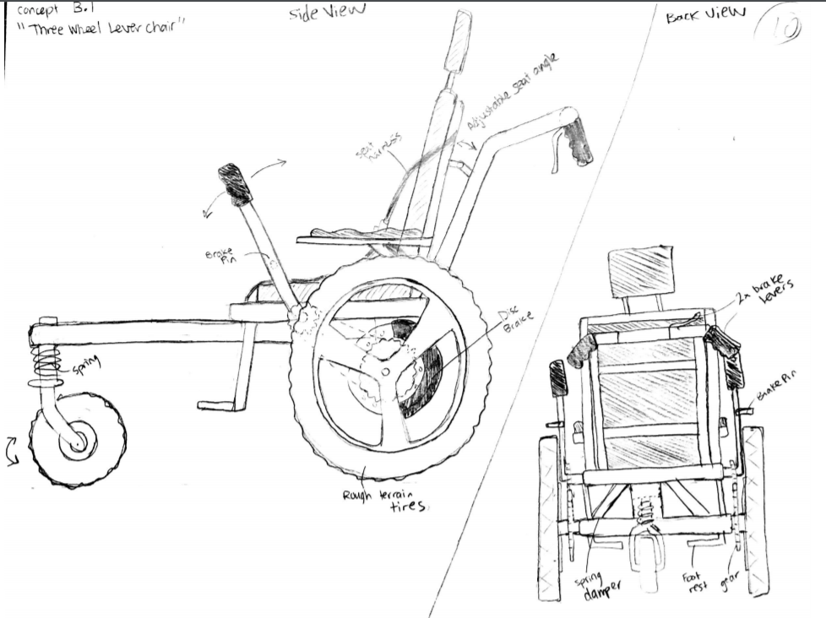
Concept B.1: “Three Wheel Lever Chair”
Strategy
Concept Gen.
Scoring
DFMEA
Project Outcome

Slide 24
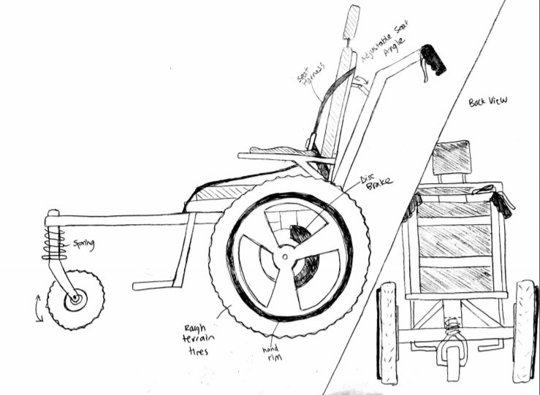
Concept B.2: “Three Wheel Handrim Chair”
Strategy
Concept Gen.
Scoring
DFMEA
Project Outcome

Slide 25
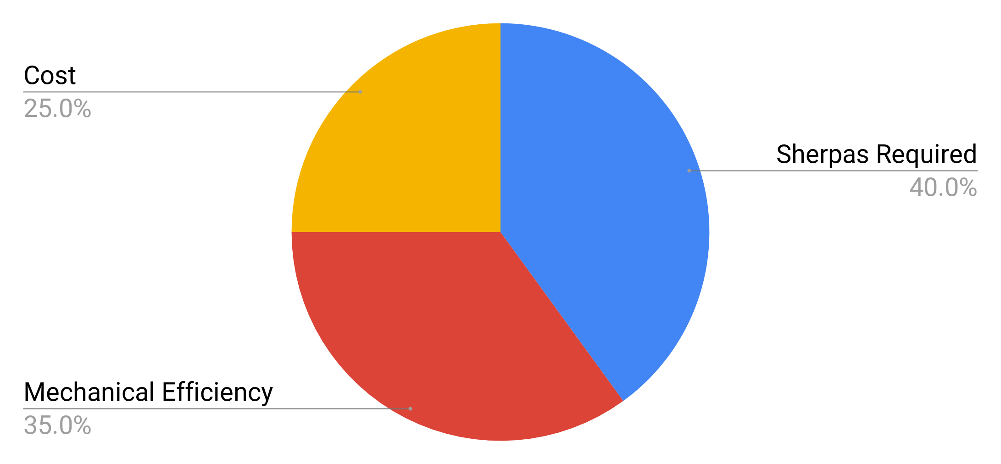
WDM Evaluation Criteria
Out of scope criteria
Rider comfort
Durability
Portability
Strategy
Concept Gen.
Scoring
DFMEA
Project Outcome
Notes:
We used a WDM to evaluate these four concepts
Evaluation criteria came directly from the high-priority needs that Julia discussed
Cost was estimated based on comparable products on the market, the Joelette and the GRIT freedom chair
Mechanical efficiency was assigned for each driving method based on research found in academic journals
The number of Sherpas required is based on a standard BCMOS trip to stanley park
Other needs that were lower priority were not addressed in detail during concept generation, and so they weren’t used as evaluation criteria
There’s many more needs that weren’t considered than just shown on the screen, but some of the largest ones that were out of scope are rider comfort, durability and portability

Slide 26
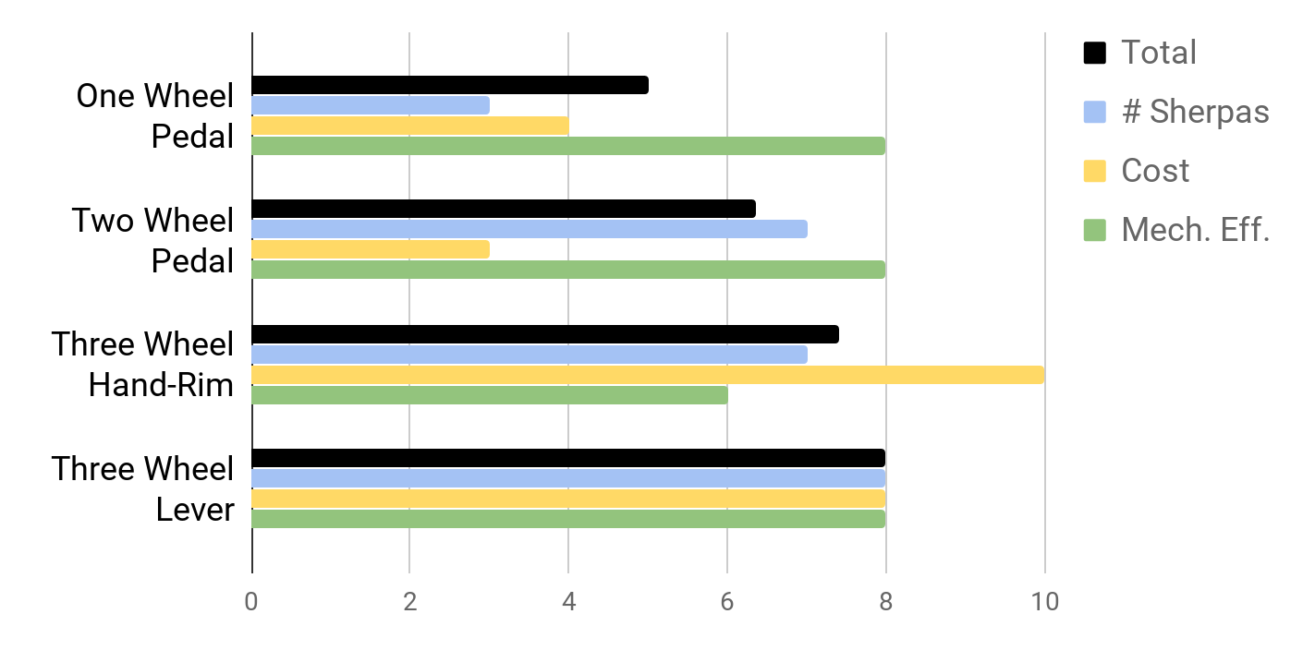
WDM Scoring
Strategy
Concept Gen.
Scoring
DFMEA
Project Outcome
Notes:
These are the results of the WDM
The one wheel design scored very low because it needs two sherpas to simply remain upright while in motion
The three wheel lever design scored slightly higher than the other two in terms of the number of sherpas required because of the mechanical advantage of using levers. By positioning the rider’s hands higher up on the lever, more torque can be applied to overcome more obstacles independently
In terms of cost, research agreed with intuition where the larger frame designs, similar to the style of the TrailRider, are more expensive on the market than the three wheel design that more closely resembles a standard wheelchair
The mechanical efficiency of pedals is the same as levers, but hand-rim propulsion is lower
Overall, the three wheel lever chair scored the highest in the WDM
If we had weighted cost more heavily, the hand rim propulsion method would have won, but our most important design goal was to improve user independence the best that we could

Slide 27
Highest Scoring Design: Three-Wheeled Lever Chair
Function | Solution
Device enables rider input towards propulsion | Lever drive system
Device accepts input from Sherpa(s) | Rear push handles
Device absorbs bumps | Mountain bike tires
Strategy
Concept Gen.
Scoring
DFMEA
Project Outcome
Notes:
Here’s the sketch for the highest scoring design
And a quick summary of how this device meets the three functions that were originally laid out by Julia

Slide 28
High RPN Failure Modes
Failure Mode | Severity |  | Occurrence |  | RPN
 | Effect | Severity | Cause | Occurrence
Chain breaks | Loss of rider propulsion (S=7) | 8 | Link-plate fatigue | 7 | 56
 | Device goes out of control (S=8) | 8 | Roller fatigue | 7 | 56
 |  |  | Excessive wear/galling | 8 | 64
Strategy
Concept Gen.
Scoring
DFMEA
Project Outcome
Notes:
Moving forward, our detailed design decisions were directly influenced by a DMFEA
On these next two slides I’m going to show the highest RPN items that we identified
The first set of items is related to the chain failing, as shown here
The occurrence is rated highly initially due to a lack of knowledge.
Our team’s approach was to rate items conservatively until sufficient evidence was available to decrease the rating

Slide 29
High RPN Failure Modes
Failure Mode | Severity |  | Occurrence |  | RPN
 | Effect | Severity | Cause | Occurrence
User cannot provide sufficient propulsion power | Rider guilt (S=8) | 8 | Train value is too high or too low | 8 | 64
 |  |  | Train value is not appropriate for all riders | 9 | 72
Strategy
Concept Gen.
Scoring
DFMEA
Project Outcome
Notes:
The train value also produced two high RPN items
The effect of rider guilt is rated with an 8 because the primary function of our device is to eliminate rider guilt by providing rider interaction, and failure to do so effectively would be a high severity failure
Two potential issues were identified, the first is that the train value is chosen without sufficient research and it does not meet any rider’s physical capabilities
The second is that the train value is optimal for a specific type of rider, but does not work universally
Again, these items were rated conservatively due to a lack of knowledge around the topic

Slide 30
Chain Analysis Process
High RPN failure mode due to large uncertainty
Shigley’s Chapter 17-5 Analysis
Safety factor on the chain shown to be >7
RPN Decreased
Strategy
Concept Gen.
Scoring
DFMEA
Project Outcome
Notes:
This is the process that was followed to address the DMFEA items related to chain failure
As seen, after following the analysis procedure laid out in Shigley’s chapter 17-5, we found that the safety factor on the chain is greater than 7
Our team laid out a requirement that the safety factor for the drive system must be greater than 2
Since we are well above two, the RPN can be safely decreased because there is sufficient evidence to do so

Slide 31
Train Value Design Process
High RPN failure mode due to large uncertainty
Development of governing equations
Power input shown to have a large impact on optimal train value
More design work required
Strategy
Concept Gen.
Scoring
DFMEA
Project Outcome
Notes:
The process for the train value required more steps
The first failure mode, which simply arose from poor train value selection, was addressed in the second step of this flow chart
To do that, we developed the governing train value equations and estimated the relevant parameters, for example rider mass, chair mass, rolling resistance and power input
Based on the values that we assigned, we calculated that the optimal train value was approximately 0.7
However, we also found that the power input from the user has a substantial impact on the optimal train value
So the second failure mode related to the train value was not addressed, which stated the train value was not universally appropriate for all riders

Slide 32
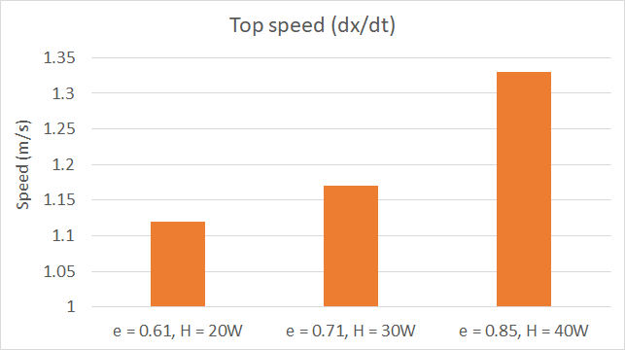
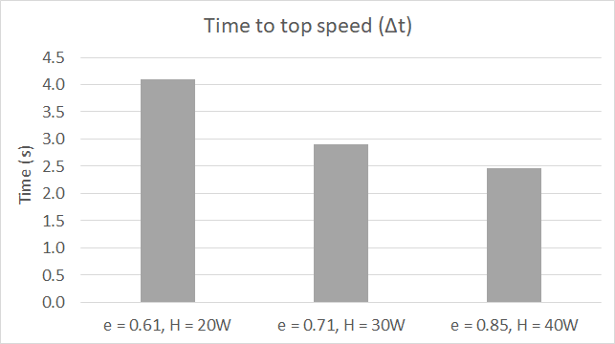
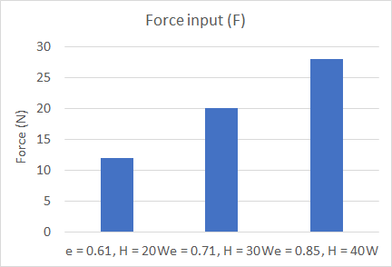
Variable Train Value Solution
Strategy
Concept Gen.
Scoring
DFMEA
Project Outcome
Notes:
To address this concern, we decided to include a variable train value option to accommodate differing power input capabilities
The train value can be requested upon purchase of the device, but during use it will still remain one-speed
This figure shows the top speed of the device at each power input and the corresponding train value
So, 0.61 is the lowest train value, for users that are only capable of outputting 20W over the duration of an average trip
This results in a top speed of just above 1.1 m/s.
This plot isn’t linear because the train value also depends on the desire acceleration from rest, which is shown in the next figure

Slide 33
Variable Train Value Solution
Strategy
Concept Gen.
Scoring
DFMEA
Project Outcome
Notes:
So here’s the acceleration of the device with each train value and power input, measured as the time to reach the top speed, where the top speeds are the ones from the previous slide

Slide 34
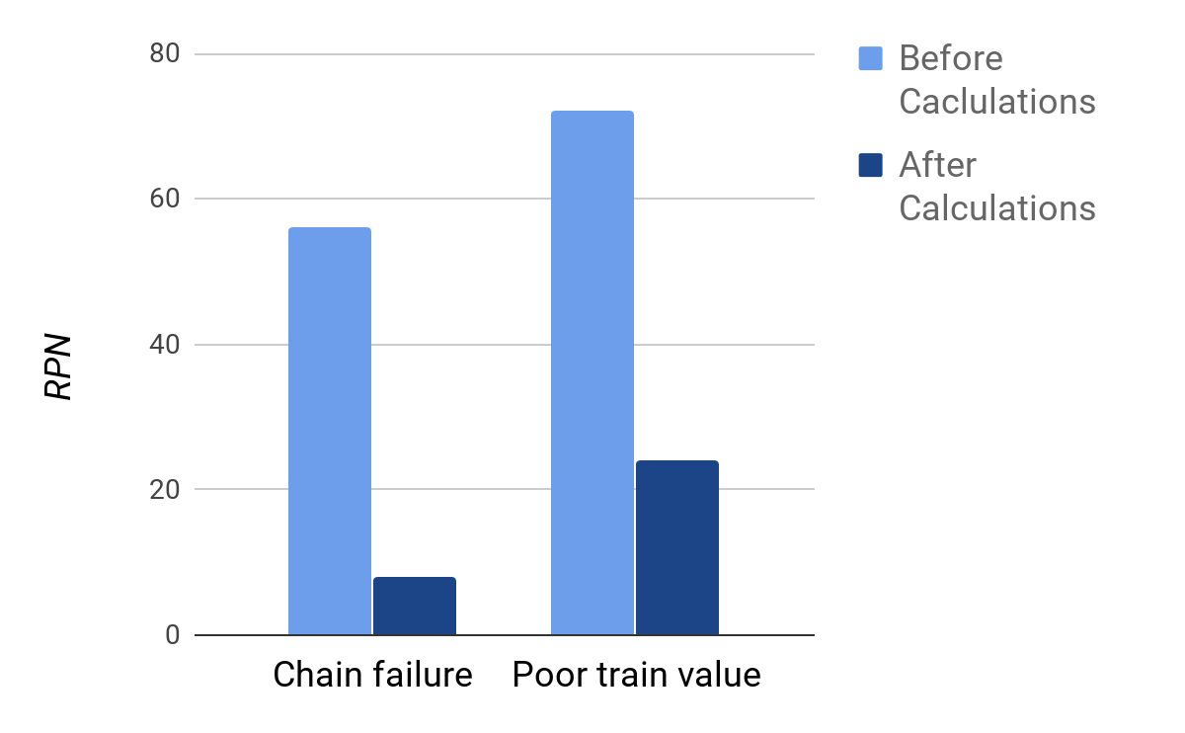
Summary of Impact on RPN
Strategy
Concept Gen.
Scoring
DFMEA
Project Outcome
Notes:
After following those two processes to address the high RPN concerns, we had enough evidence to decrease the likelihood of failure
So, the RPN for chain failure decreased from 56 to 8 as a result of our calculations
And the RPN of an inappropriate train value decreased from 72 to 24
We would not be able to decrease the train value RPN further until physical testing could be done
Now I’ll hand it over to stephen who will discuss the remaining work of the project

Slide 35
Remaining Work
Next Highest RPN Components | Risks Involved | Recommendations
Frame | Buckling | SolidWorks Finite Element Analysis
Sherpa Handle | Bending | Beam Bending Calculation
Sprocket | Fatigue | Load and Fatigue Life Calculations
Strategy
Concept Gen.
Scoring
DFMEA
Project Outcome
Notes:
Thanks Carson.
With the time given to complete the project, we didn’t get to address all of the failure modes we identified. The next highest risk priority numbers are associated with the frame, the sherpa handles, and the sprockets.
The risk involved with the frame is buckling due to impact. If we had more time we would do finite element analysis in SolidWorks.
The risk involved with the sherpa handle is bending due lifting force. If we had more time we would do beam bending calculations to make sure it’s strong enough.
The risk involved with the sprocket is fatigue due to many cycles. If we had more time we would do load and fatigue life calculations to make sure it lasts.

Slide 36
Project Cost
Kept individual logbooks to track work
Aimed to work 8 hours a week as a group
384 engineering hours X $150/h = $57,600
Strategy
Concept Gen.
Scoring
DFMEA
Project Outcome
Notes:
To track the cost of the project, we kept log books to record our working hours.
We aimed to work 8 hours a week as a group resulting in 384 engineering hours charged at a rate of $150 per hour for a total of $57,600.

Slide 37
Lessons Learned
Have a well defined and realistic scope so that expectations are met
Pay close attention to tasks that are prerequisites to other tasks to avoid delays
Prioritize important tasks; do not get caught up on small details
Strategy
Concept Gen.
Scoring
DFMEA
Project Outcome
Notes:
We learned several things throughout this project.
One is to have a well defined and realistic scope so that expectations are met.
Another is to pay close attention to tasks that are prerequisites to other tasks to avoid delays.
Lastly is to prioritize important tasks and to not get caught up on small details.
Now Julia will close us off.

Slide 38
Questions?

